Slide 1
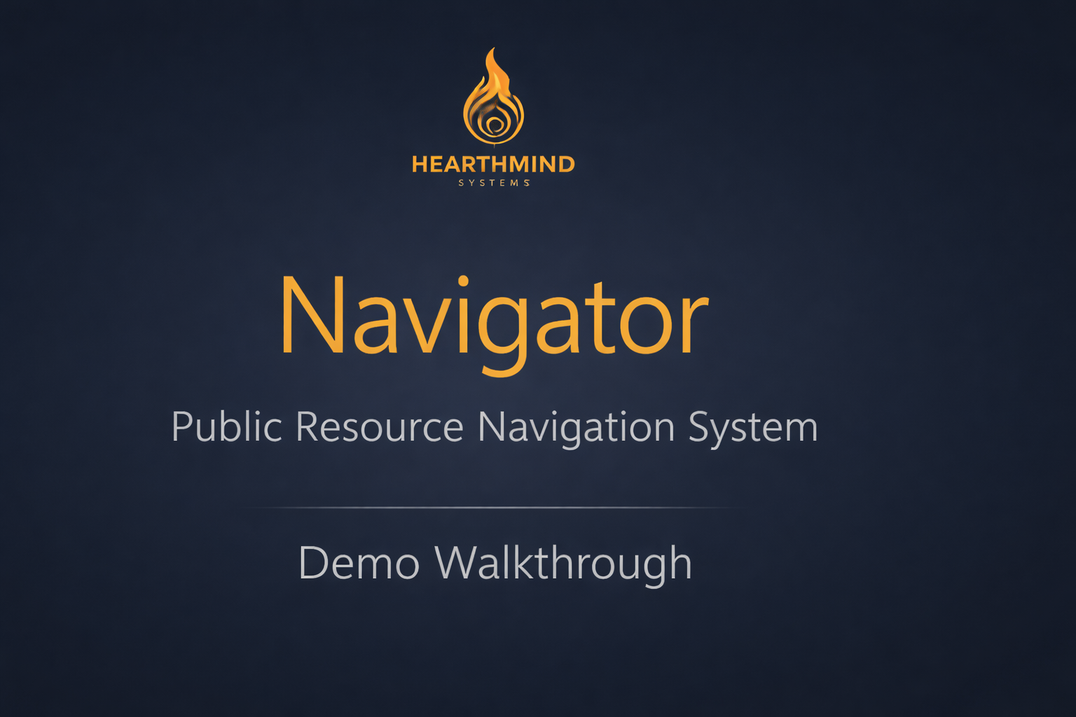

Slide 2
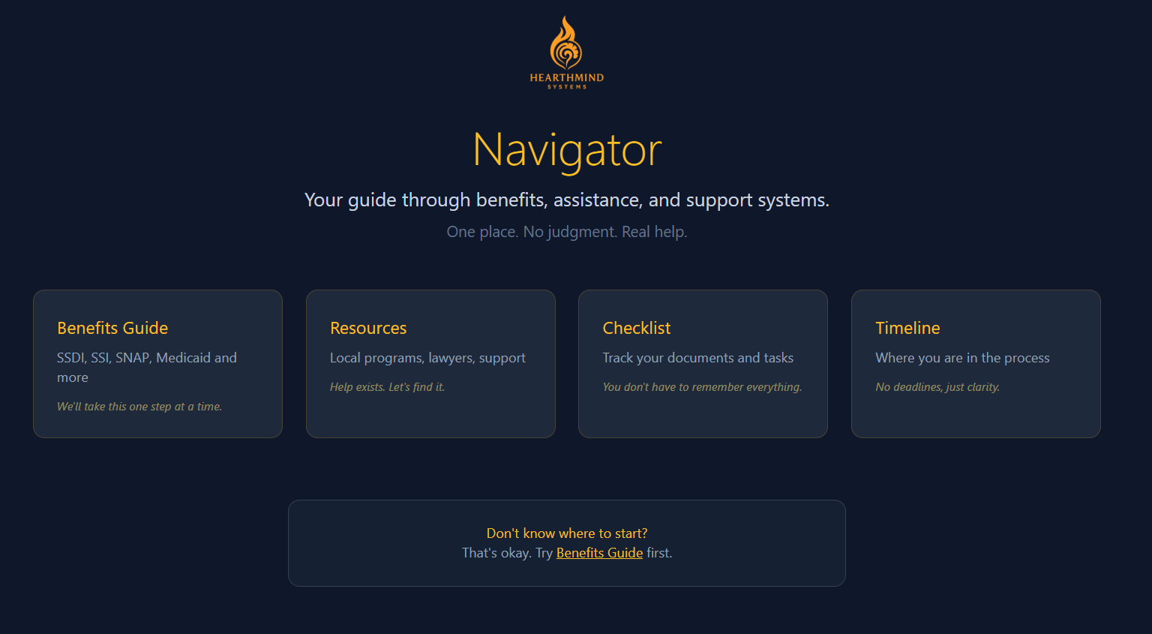

Slide 3
Navigator is a public-resource navigation system built by HearthMind.
It helps people find benefits, services, and next steps based on their situation

Slide 4
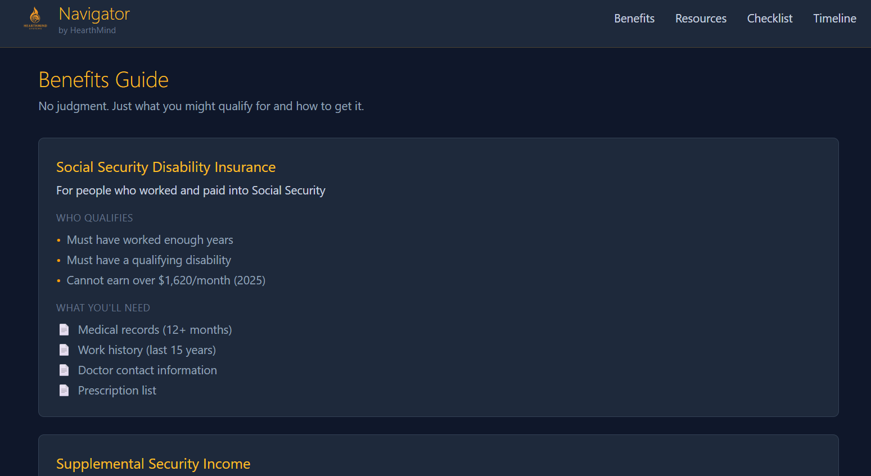
“Navigator includes structured guidance for major public programs such as SNAP, SSDI, and SSI.”
“Each program shows who qualifies and what documentation is needed.”
“Navigator includes structured guidance for major public programs such as SNAP, SSDI, and SSI.”
“Each program shows who qualifies and what documentation is needed.”

Slide 5
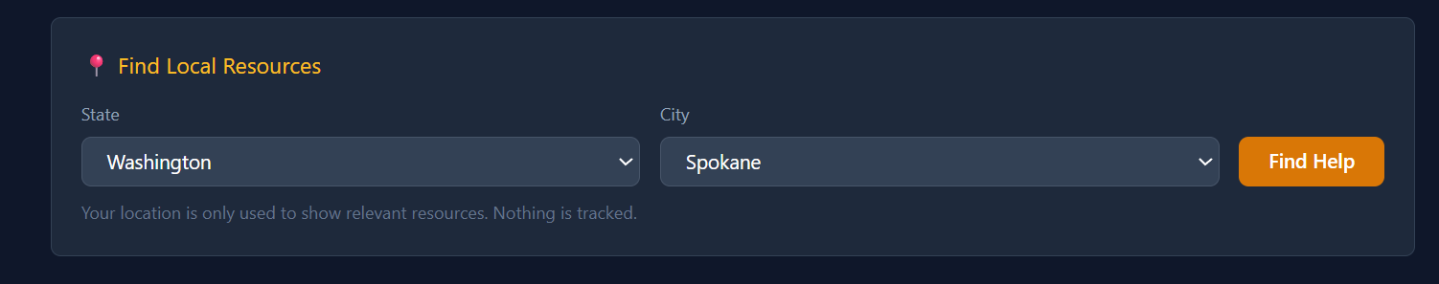
“Users can search for real local resources by state and city.”“Navigator only uses location to display relevant help. Nothing is tracked.”

Slide 6
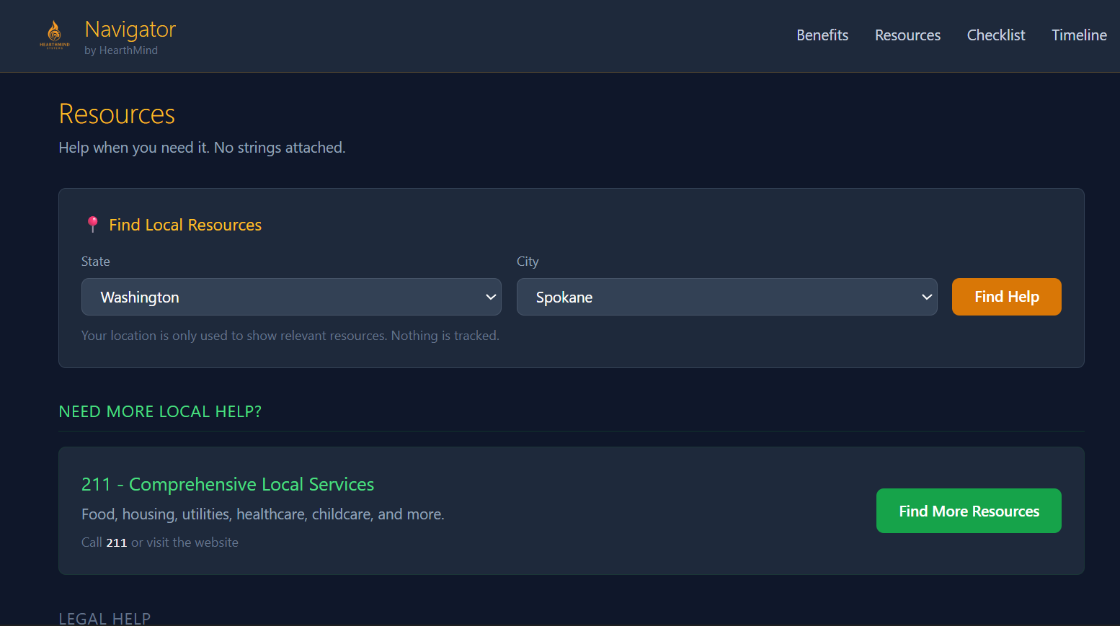

Slide 7
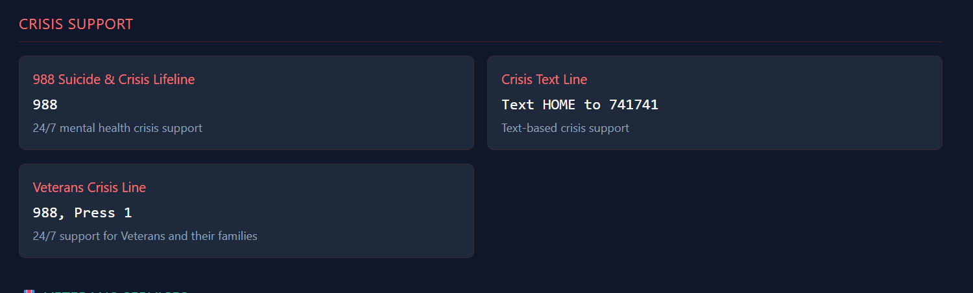
“The system surfaces crisis support, technology access, legal help, and community support resources.”

Slide 8
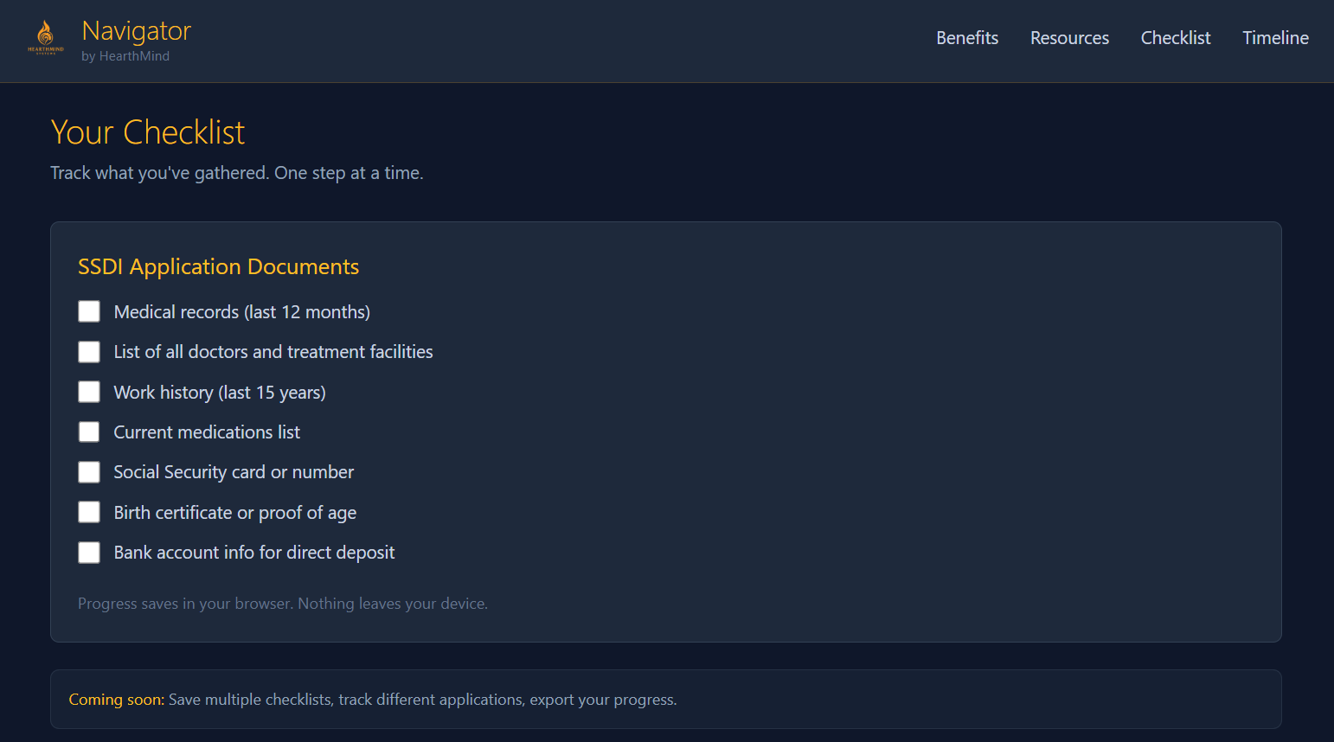
“Navigator provides interactive checklists that help users track required documents and steps.”“Progress is stored locally in the browser.”

Slide 9
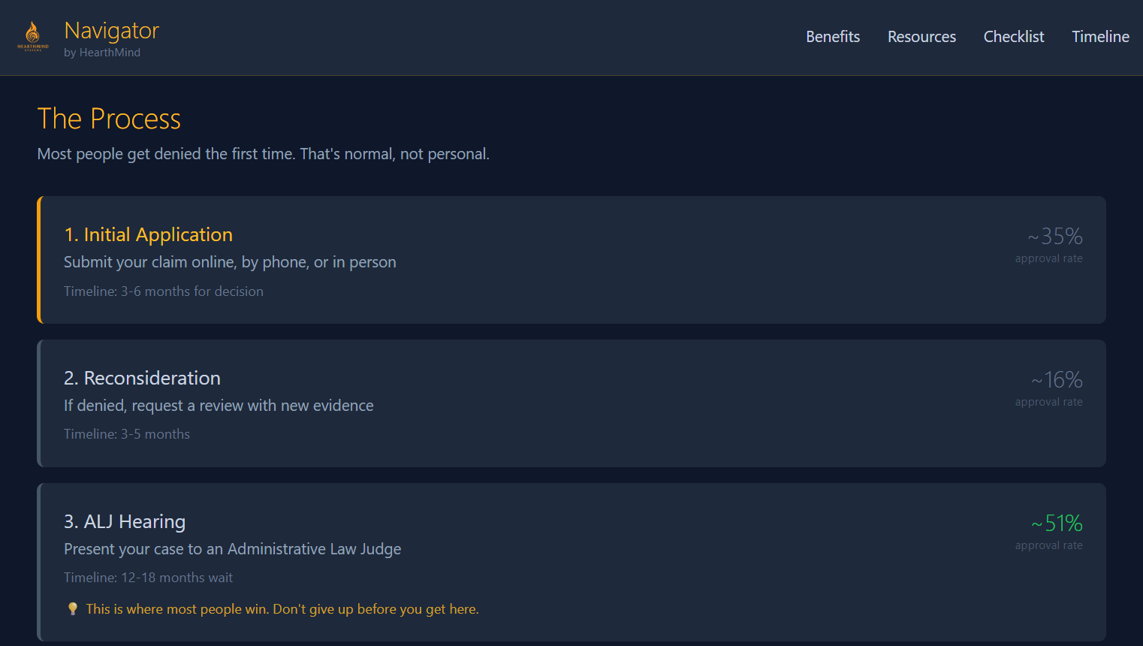
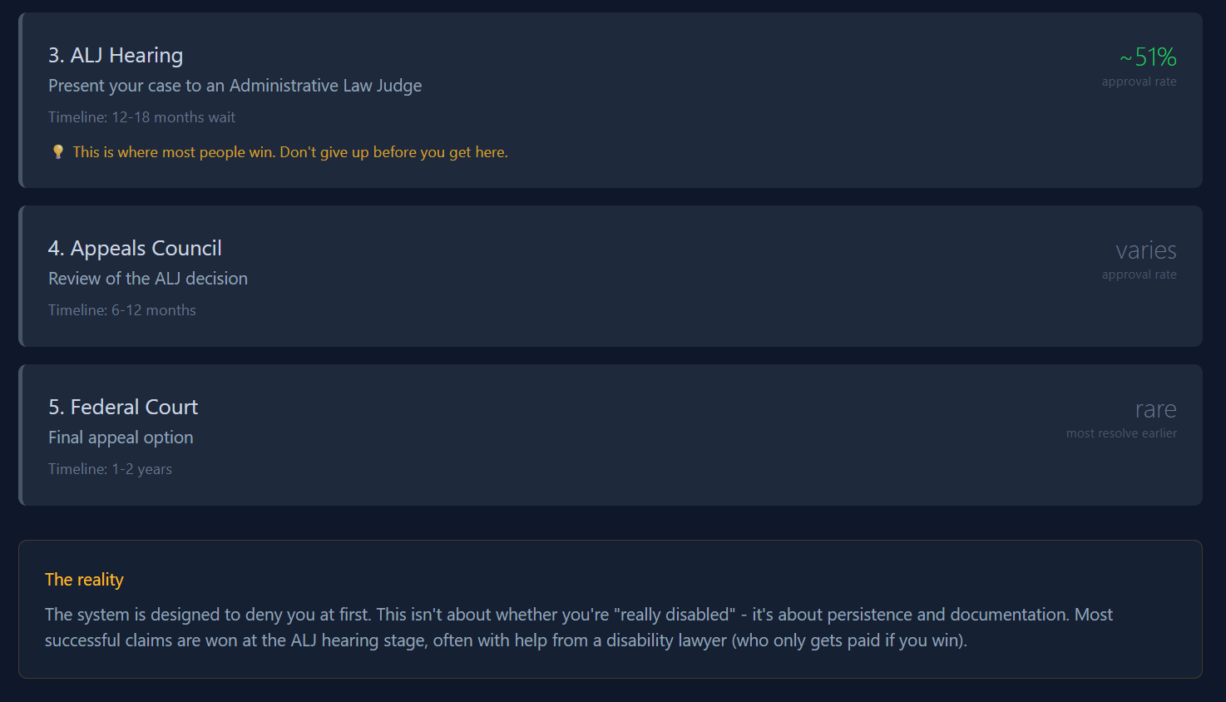
“The timeline shows where users are in the application process and what to expect at each stage.”

Slide 10
“This walkthrough shows a real, functioning Navigator system currently operating in live beta.”

Slide 11
Future Features (Planned Enhancements)
Multi-Checklist Profiles
Save and manage separate application checklists for different programs (SSDI, SSI, SNAP, housing, etc.).
Progress Export
Download or print your checklist progress for use with caseworkers, lawyers, or advocates.
Application Timelines by Program
View realistic wait times and next-step expectations by benefit type and state.
Local Resource Auto-Updates
Automatic refresh of local resource directories by region.
Secure Account Sync (Optional)
Optional sign-in to save progress across devices — still privacy-first.
Advocate / Helper Mode
Shared view for caseworkers, family, or support advocates to assist users.

